Slide 1
Strings and Text Files
in
Python

Slide 2
Substring
String is a bunch of characters
You can access character in string using ”[]

Slide 3
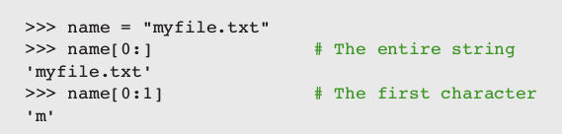
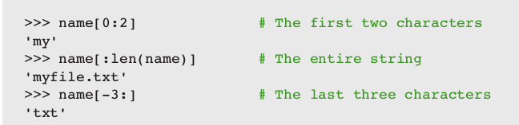
Slicing
String is a bunch of characters
You can access character in string using ”:”

Slide 4
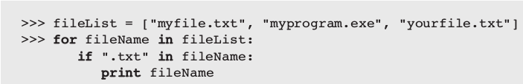
Testing for a Substring with the in Operator
When used with strings, the left operand of in is a target substring and the right operand is the string to be searched.
The operator in returns True if the target string is somewhere in the search string, or False otherwise.

Slide 5
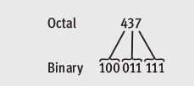
Convert Octal base number into binary base number
Each digit in octal base number convert into three digits binary base number
Example

Slide 6
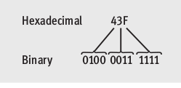
Convert Hexa base number into binary base number
Each digit in Hexa base number convert into four digits binary base number
Example

Slide 7
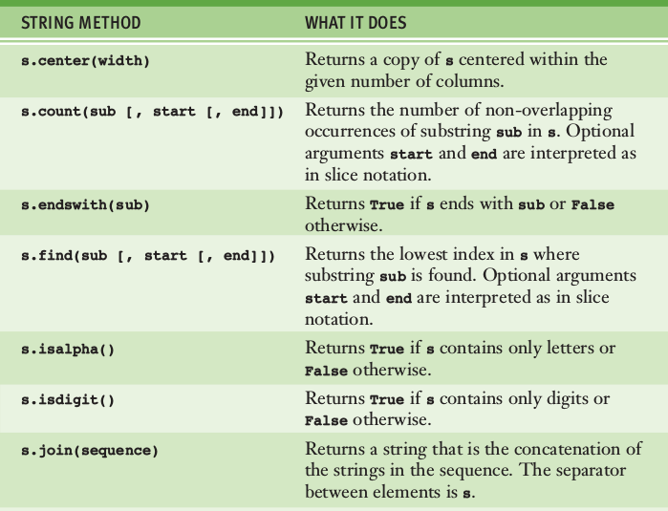
String Methods - 1

Slide 8
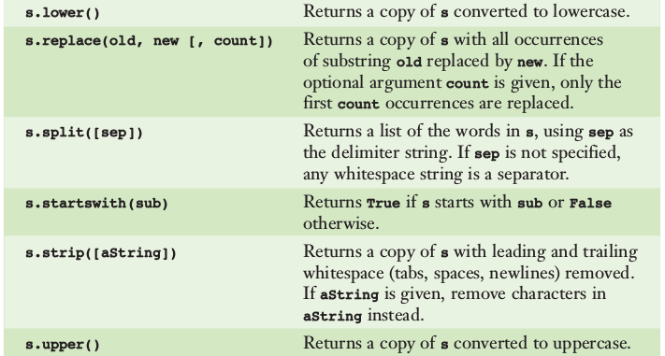
String Methods - 2

Slide 9

Writing Text to A File - 1
Data can be output to a text file using a file object
Python’s open function, which expects a file pathname and a mode string as arguments, opens a connection to the file on disk and returns a file object.
The mode string is 'r' for input files and 'w' for output files.

Slide 10

Writing Text to A File - 2
Use write method to write output to the file
The write method expects a single string argument
Don’t forget to close the file if you have finished use it

Slide 11
Text File Exercise
Make an application to write random number from 1 – 500 to text file. Name of text file is random.txt. Amount of loop iterations is 500

Slide 12

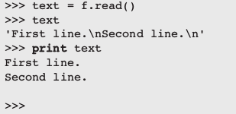
Read Text From a File - 1
Use r argument in open method to read the text file
There are several ways to read data from an input file. The simplest way is to use the file method read to input the entire contents of the file as a single string. If the file contains multiple lines of text, the newline characters will be embedded in this string.

Slide 13
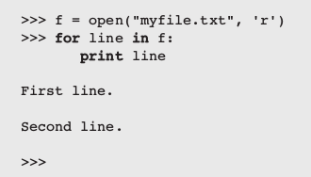
Read Text From a File - 2
You can use for loop to process the text one line at a time

Slide 14
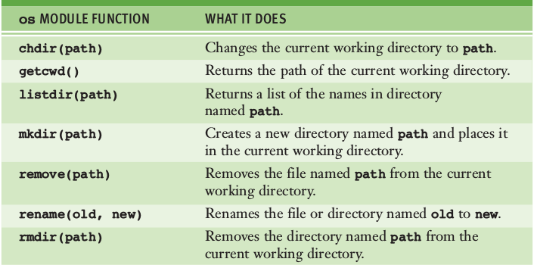
OS Module Functions

Slide 15
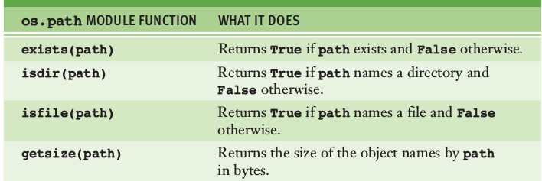
OS Path Module Functions

Slide 16
First Home Work
Make an application which can save, read and write a binary data to a binary file.

Slide 17
Reference
Fundamentals of Python from First Program Through Data Structures Chapter 4

